Slide 1

DIGITAL PORTFOLIO !!
STUDENT NAME: YUVARANISRI S. M.
REGISTER NO AND NMID: 222403871/asumn293222403871
DEPARTMENT: COMPUTER SCIENCE
COLLEGE: VIDHYA SAGAR WOMENS COLLEGE

Slide 2
PROJECT TITLE
DIGITAL PORTFOLIO

Slide 3


AGENDA:
Problem Statement
Project Overview
End Users
Tools and Technologies
Portfolio design and Layout
Features and Functionality
Results and Screenshots
Conclusion
Github Link

Slide 4

PROBLEM STATEMENT
In the modern digital era, simply having skills or projects is not enough; presenting them effectively is equally important. Many students and professionals lack a structured platform to display their talents, achievements, and learning experiences. Traditional methods like paper resumes or scattered social profiles do not provide a comprehensive or interactive view. Hence, there is a need for a digital portfolio that is user-friendly, visually appealing, and organized, allowing individuals to showcase their abilities, projects, and accomplishments in a professional and accessible manner.

Slide 5
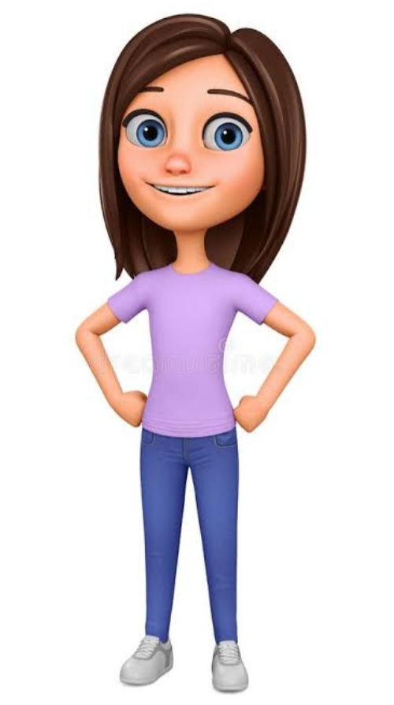
PROJECT OVERVIEW
The Digital Portfolio showcases skills, projects, education, and achievements in one place.It is interactive, easy to update, and accessible online.Sections include About Me, Skills, Projects, Education, and Contact.Helps personal branding and leaves a strong impression on recruiters or educators.
It is an overview of HTML CSS JAVASCRIPT

Slide 6
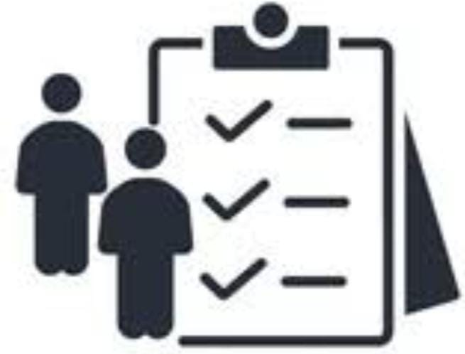


WHO ARE THE END USERS?
Students → To showcase their projects and skills. Fresher's / Job Seekers → To present their portfolio to recruiters. Employers / Recruiters → To quickly evaluate candidates. General Audience → To know more about the developer.

Slide 7

TOOLS AND TECHNIQUES
1.HTML – for creating the structure of web pages. 2.CSS – for styling and making the portfolio visually appealing. 3.JavaScript – for adding interactivity and dynamic features. 4.GitHub – for version control and hosting the project online. 5.CodePen – for testing, experimenting, and sharing code snippets.

Slide 8

POTFOLIO DESIGN AND LAYOUT
A portfolio showcases an individual’s skills, creativity, and achievements. Design layout is the structured arrangement of elements that makes the portfolio attractive and easy to navigate. A good layout ensures clarity, consistency, and a professional look
8

Slide 9

FEATURES AND FUNCTIONALITY
1.HTML Structure → Header, About, Skills, Projects, Contact, Footer. 2.CSS Styling → Colours, responsive layout, cards, sticky nav. 3.JavaScript → Smooth scroll, mobile menu toggle, form validation. 4.Responsive Design → Works on mobile, tablet & desktop. 5.Contact Section → Email, LinkedIn, phone with functional form.

Slide 10

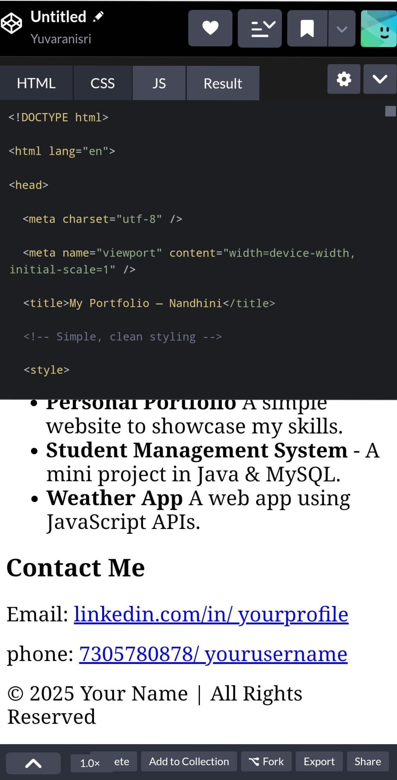
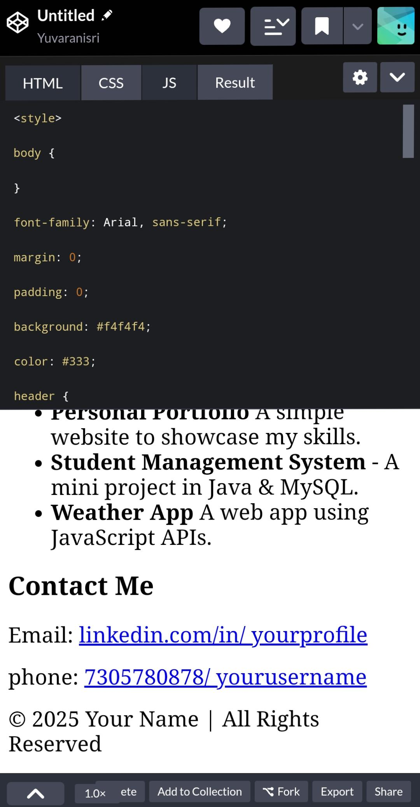
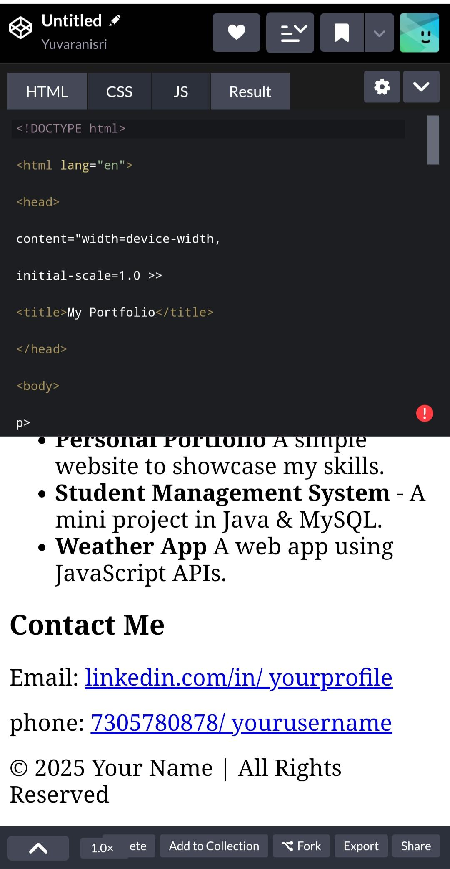
RESULTS AND SCREENSHOTS
10

Slide 11

ABOUT ME
I am yuvaranisri S. M. a B.Sc Computer Science student with an interest in IT and design. I enjoy creating digital content and learning new technologies. My goal is to build a career in IT while improving my creative and technical

Slide 12

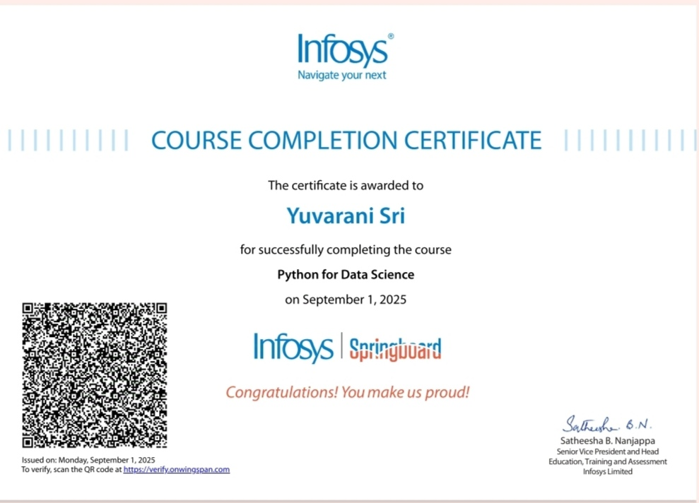

SKILLS
1.Certified in Python for Data Science by Infosys Springboard 2.Skilled in Python programming and data handling 3.Knowledge in data visualization, libraries, and analytics 4.Strong foundation in problem-solving and logical thinking

Slide 13

CONTACT
NM ID: asumn293222403871
EMAIL ID : yuvaranisri26@gmail.com
PHONE NO : 7305780878

Slide 14

CONCLUSION
The Digital Portfolio provides a modern, organized, and interactive platform to showcase skills, projects, and achievements. It helps students and professionals create a strong online presence, enhance personal branding, and stand out to recruiters or educators. This project demonstrates the effective use of HTML, CSS, JavaScript, GitHub, and CodePen to build a professional and user-friendly portfolio.
THANKING YOU
14

